Slide 1


Welcome to Reed Medical Ltd
An introduction to Footwear

Slide 2
Therapeutic Footwear
Therapeutic Footwear is prescribed with the aim of:
preventing or reducing the risk of foot disease
preventing or reducing the complications of diseases affecting the foot
accommodating foot deformity
facilitating improved gait and thus reducing musculoskeletal disease or deformity progression where possible.
These goals are achieved by providing footwear that is sufficiently cosmetically acceptable to the patient that they can carry out as much of the normal activities of daily life as possible
Notes:
So what is therapeutic footwear, what does it do and when should we consider prescribing it?
Colleagues at Homerton Podiatry and Footwear Centre have come up with a concise criteria for prescription.

Slide 3
Therapeutic Footwear should be considered:
When the foot cannot be accommodated in high street footwear or comfort footwear (DB, Hotter, Cosyfeet etc).
When the construction of the footwear needs to suit a specific condition (eg soft uppers, extra stiffening, safeseam construction etc)
Notes:
In short.
Therapeutic footwear should be considered- - - - - -

Slide 4
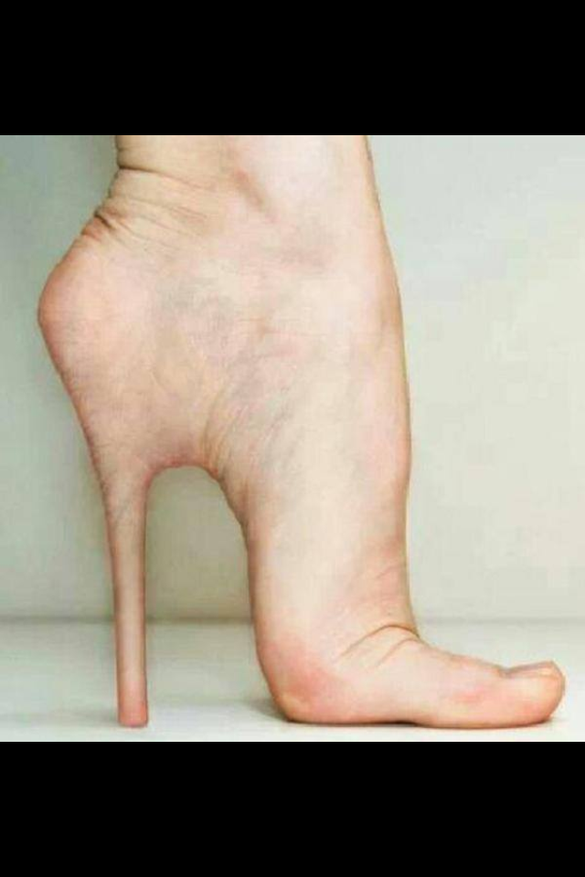
The Last
All footwear is made on a last, which is a wooden or plastic representation of the foot, upon which the shoe is made.
It is not a model of the foot! Fitting allowances are added to your measures & the shape blended for cosmesis.
It is fashioned to provide a good fit, whilst allowing for changes in the foot when walking.
Notes:
The starting point for the manufacture of footwear is the Last, which is a solid block around which the shoe is made.
The last is not a model of the foot. It is a representation of the foot which is fashioned to provide a good fit, whilst allowing for changes in the foot when walking.
SHOW EXAMPLE OF LAST.

Slide 5
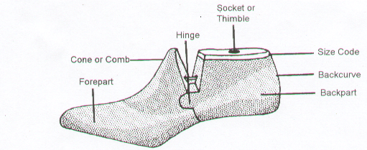
Parts of a Last

Slide 6
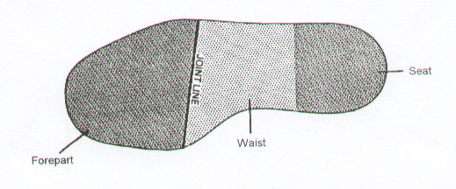
Areas of a Last
Notes:
Although the last is not a model of the foot, it is important for the widest part of the foot (across the metatarsal heads) should coincide with the widest part of the last (joint line).

Slide 7
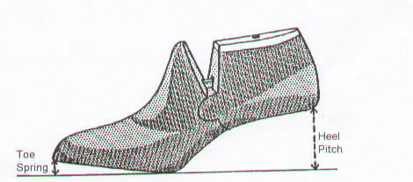
Toe Spring and Heel Pitch
Heel pitch is the difference in height between the heel and sole. This ensures that the joint line is in contact with the ground and there is adequate toe spring.
If increased heel height is required (equinus), then a special last will need to be made with correct pitch.
Notes:
Lasts are pitched to take a particular heel height while maintaining adequate toe spring. The last and therefore the finished shoe should pivot along the joint line.
The pitch is the difference in height between the heel and the sole.
If the pitch needs to be increased, as in the case of an equinus foot, a bespoke last will have to be made.

Slide 8
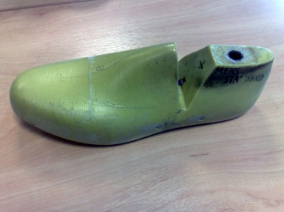
Stock Footwear
This is a name given describe manufactured on a standard last, calibrated according to the manufacturer’s accommodation chart.
Standard lengths with various width/depth measures (narrow, standard, wide and deep)
Notes:
There are three main types of therapeutic footwear. Stock, modular and bespoke.
Stock footwear has become a little bit of a misnomer, as most are made to order and not bulk manufactured.
The term stock footwear has now become a bit of a misnomer as the shoes are not bulk manufactured and held in stock, but made to order.
They are produced on standard lasts, calibrated according to manufacturer’s accommodation chart.
The basic specification can be altered to clinician’s prescription.

Slide 9
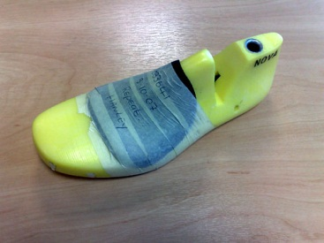
Types of Therapeutic Footwear
MODULAR FOOTWEAR is made on a last which has been adapted by adding fittings to accommodate bunions, hammer toes etc.
The shape of the sole remains standard as does the pitch of the last. (the difference in depth between heel and sole).
Notes:
, to improve fit before makingIf the dimensions of the foot fall outside the accommodation chart, then additions can be made to specific areas on the last before making to improve fit, resulting in modular footwear.
These last adaptions can be removed on completion of the order and details retained for repeat orders. We are then able to retain the stock last for future orders.
Although we have altered the dimensions of the last, we have not compromised the bottom shape or the pitch of the last.

Slide 10
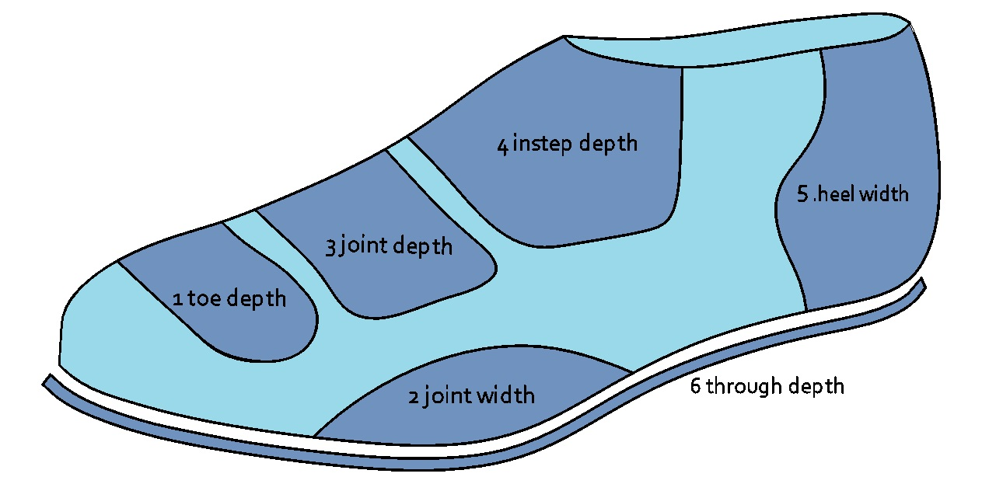

Slide 11
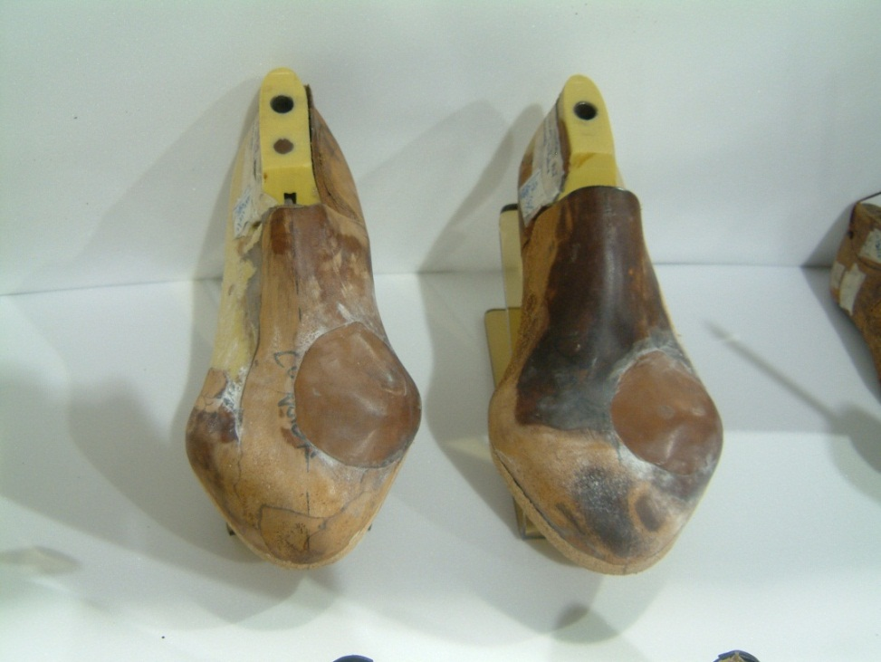
Types of Therapeutic Footwear
BESPOKE FOOTWEAR When the dimensions of the foot alter the shape of the sole unit, or the pitch of the foot exceeds the standard pitch (equinus foot), specific lasts have to be produced and bespoke footwear made.

Slide 12
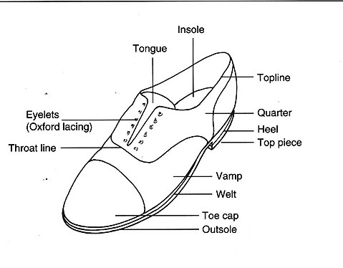
The Parts of a Shoe
Notes:
Explain difference between oxford and gibson (use own shoes as examples).
Oxford – quarters under vamp
Gibson – quarters on top of vamp

Slide 13
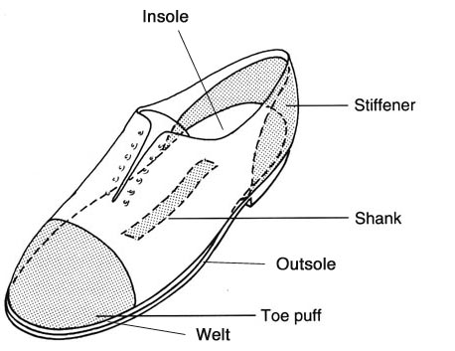
The Parts of a Shoe

Slide 14
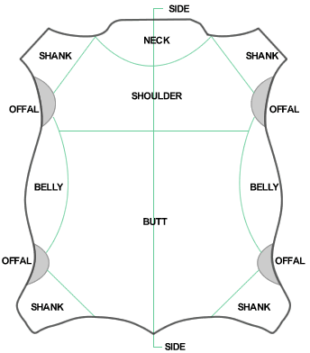
Upper Materials
Leather is widely used in footwear manufacture, being permeable and able to mould to a shape.
Manufacturing leather takes a waste product from one industry, meat production, and turns it into a useful commodity.
Notes:
Give brief description of journey from farm to shoe.
How the skin is scraped and the gelatin used in jelly babies, lipstick etc.

Slide 15
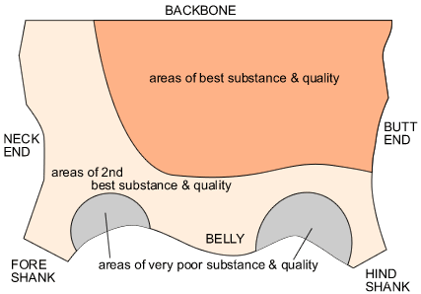
Leather Quality
When cutting leather, it is important to cut the components along the line of least stretch, so that the shoe holds its shape.
This is known as cutting ‘TIGHT TO TOE’
Notes:
The butt area is less affected by over stretching and abrasions.

Slide 16
Upper Materials
There are a number of synthetic materials that behave like leather but have to be purchased in large quantities. The use of leather is therefore more economical for the relatively small orthotic footwear industry.
Calf skin, being young and less damaged by the rigours of life, produces high quality leather. This leather is in shorter supply and therefore very expensive. The therapeutic footwear industry favours use of the larger cow hides.

Slide 17
Linings
Although the linings of many fashion shoes are made from synthetic material, it is better for the foot if the lining is breathable and has some stretch.
In therapeutic footwear we mainly use leather or superplush material for linings.
Superplush has anti bacterial and anti fungal properties, therefore, helping to create a safe environment for the foot inside the shoe.
Notes:
Show examples of leather and superplush lining.

